Slide 1
Mastering Android Development: Core Language Fundamentals

Slide 2
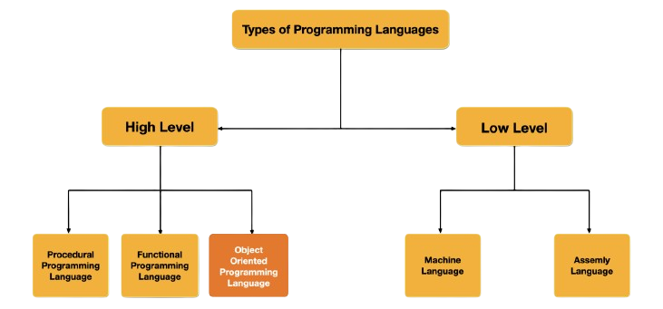

Slide 3
What is OOP?
A modular approach where data and functions can be combined into a single unit known as an object. It emphasises data and security and provides the reusability of code
Object Oriented programming (OOP) refers to a type of programming in which programmers define the data type of a data structure and the type of operations that can be applied to the data structure.
Most popular programming languages like Java, C++,PHP, Python, C#, etc. follow an object-oriented programming methodology.

Slide 4
Building Blocks Of OOP
Objects: Objects are instances of classes, representing elements like buttons or screens in your app, with data and ways to manipulate that data.
Classes: Classes are blueprints for creating objects, defining what data and actions those objects will have.
Inheritance: Inheritance allows a class to use properties and methods of another class, facilitating code reuse and organization.
Encapsulation: Encapsulation hides the internal state of an object and requires all interaction to be performed through an object's methods, protecting the object from outside interference and misuse.

Slide 5
Building Blocks Of OOP
Polymorphism: Polymorphism lets you use a single interface to represent different underlying forms (types), allowing for a single method to work in different ways depending on the object it is acting on.
Abstraction: Abstraction focuses on hiding complex details and showing only the essential features, simplifying the approach to problem-solving in programming.

Slide 6
Two Languages :
Java
Kotlin

Slide 7
Languages using in android
Firstly Java was the official language for Android App Development (but now it was replaced by Kotlin) and consequently, it is the most used language as well.
Now Kotlin is the official language for Android App Development declared by Google in 2019.

Slide 8
Fundamentals of Android
Android Programming Languages
In Android, basically, programming is done in two languages JAVA or C++ and XML(Extension Markup Language). Nowadays KOTLIN is also preferred.

Slide 9
Android Versions and Their Names
Name | Internal codename | Version number(s)
Android 1.0 | — | 1
Android 1.1 | Petit Four | 1.1
Android Cupcake | Cupcake | 1.5
Android Donut | Donut | 1.6
Android Eclair | Eclair | 2
 |  | 2.0.1
 |  | 2.1
Android Froyo | Froyo | 2.2 – 2.2.3
Android Gingerbread | Gingerbread | 2.3 – 2.3.2
 |  | 2.3.3 – 2.3.7
Android Honeycomb | Honeycomb | 3
 |  | 3.1
 |  | 3.2 – 3.2.6
Android Ice Cream Sandwich | Ice Cream Sandwich | 4.0 – 4.0.2
 |  | 4.0.3 – 4.0.4
Android Jelly Bean | Jelly Bean | 4.1 – 4.1.2
 |  | 4.2 – 4.2.2
 |  | 4.3 – 4.3.1

Slide 10
Android Versions and Their Names
Name | Internal codename | Version number(s)
Android KitKat | Key Lime Pie | 4.4 – 4.4.4
 |  | 4.4W – 4.4W.2
Android Lollipop | Lemon Meringue Pie | 5.0 – 5.0.2
 |  | 5.1 – 5.1.1
Android Marshmallow | Macadamia Nut Cookie | 6.0 – 6.0.1
Android Nougat | New York Cheesecake | 7
 |  | 7.1 – 7.1.2
Android Oreo | Oatmeal Cookie | 8
 |  | 8.1
Android Pie | Pistachio Ice Cream | 9
Android 10 | Quince Tart | 10
Android 11 | Red Velvet Cake | 11
Android 12 | Snow Cone | 12
Android 12L | Snow Cone v2 | 12.1
Android 13 | Tiramisu | 13
Android 14 | Upside Down Cake | 14
Android 15 | Vanilla Ice Cream | 15

Slide 11
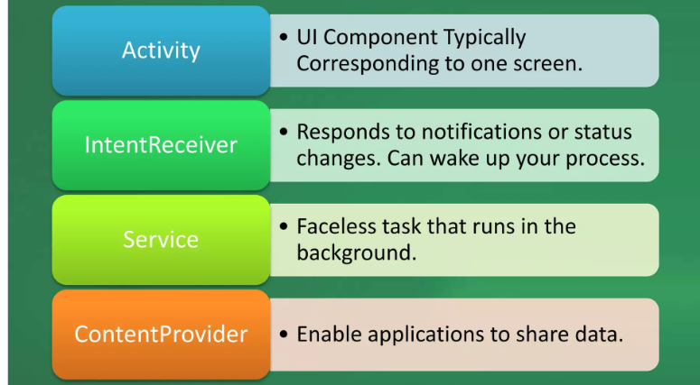
Fundamentals of Android

Slide 12
Understanding Android SDK and build process
Android SDK (Software Development Kit) :
SDK Tools: These are the fundamental tools required for Android app development. They include tools for debugging, compiling, and packaging Android apps.
Platform Tools: These tools are necessary for developing and debugging Android apps. They include ADB (Android Debug Bridge) for managing connected Android devices and emulators, among others.

Slide 13
Understanding Android SDK and build process
Build Tools: These tools are used to compile the source code, package resources, and create the APK (Android Package) file for deployment. Examples include the Android Asset Packaging Tool (AAPT) and the DEX compiler.
Platforms and APIs: The Android SDK includes various versions of Android platforms and APIs, allowing developers to target specific Android versions and utilize their features.
Documentation and Samples: The SDK provides comprehensive documentation and code samples to help developers understand and utilize various Android APIs and features effectively.

Slide 14
Understanding Android SDK and build process
Android Build Process:
Source Code: Android apps are typically written in Java, Kotlin, or other supported languages. The source code includes both application logic and resources like layouts, images, and strings.
Gradle Build Scripts: Gradle is the build system used for Android projects. Developers configure build settings, dependencies, and other project-specific configurations using Gradle build scripts (build.gradle files).

Slide 15
Compilation: The source code and resources are compiled using the appropriate build tools provided by the Android SDK. Java or Kotlin code is compiled into bytecode, XML resources are compiled, and assets are processed.
Resource Packaging: Resources such as images, layouts, and strings are packaged into a binary format optimized for Android apps using tools like AAPT (Android Asset Packaging Tool).
APK Generation: All compiled code, resources, and assets are packaged into an APK file. This file contains everything needed to run the app on an Android device.

Slide 16
Signing: The APK file is signed with a digital certificate to ensure its authenticity and integrity. This is crucial for distributing apps via app stores like Google Play.
Debugging and Testing: During development, developers can debug and test their apps using various tools provided by the Android SDK, such as ADB(Android Debug Bridge) and Android Studio's built-in emulator or connected devices.
Deployment: Once the app is ready, it can be deployed to users' devices via various distribution channels like Google Play Store, third-party app stores, or direct APK installation.

Slide 17
Introduction of Android Studio
Android Studio IDE understanding.
Android Studio is the official Integrated Development Environment (IDE) for Android App development.
It is a powerful tool that allows developers to build high-quality applications for the Android platform.

Slide 18
Introduction of Android Studio
Download Android Studio.
Download Android Studio Link.
Android Studio Installing Steps.
Installation Steps Link

Slide 19
List of Resources
List of Resources
Drawable Resources
Layout Resources
Color Resources
String Resources
Dimension Resources
Font Resources
Other Resources

Slide 20
Thank You

